Slide 1
Measurement Principles
Data Collection Procedures and Graphing Conventions in ABA

Slide 2
Why Collect Data?
Data collection is a critical component of ABA
A systematic and objective way to record and analyze skill acquisition and behavior management
Data allow us to evaluate:
how well things are going (i.e., patterns of increasing or decreasing behavior)
under what circumstances behaviors occur (e.g., functional behavior assessments
Method used depends on the skill being taught or the behavior being monitored.

Slide 3
Data Collection
Behaviors being observed should be clearly defined
Specify exactly what behavior is to be observed. Also specify any excluded behaviors.
Should be consistent
It is the primary means of measuring progress

Slide 4
Let’s Review some Terminology…
Stimulus: Any event that an organism can detect through its senses.
Response: A single instance of a behavior
Discriminative Stimulus (SD): A stimulus in the presence of which responses of some type of responses have occurred and in the absence of which the same type of responses have occurred and not been reinforced
Antecedent: An environmental condition or stimulus change existing or occurring prior to a behavior of interest
Behavior: The activity of living organisms. Does it pass the dead man’s test?
Consequence: A stimulus change that follows a behavior of interest

Slide 5
Data Collection for Assessment
ABC Data Collection
Scatter Plots

Slide 6
ABC Data Collection
A=Antecedent
What happens immediately before the target behavior (e.g., told to wait, verbally prompted to work, noise in classroom increased).
B=Behavior
An observable and measurable act (e.g. hitting, swiping materials, cursing, complying with demand)
C=Consequence
What happens immediately after the target behavior (e.g. ignoring, told to “stop”, blocking, praise)

Slide 7
ABC Data Collection
Date | Activity | Antecedent | Behavior | Consequence
9/24/16 | Arts & Crafts | Waiting for peer to finish with paint, no paint available | Pushed peer | Told to “stop and wait her turn”
9/24/16 | Arts & crafts | Painting | Doesn’t want to wait her turn | Kept doing what she wanted
Good example
Bad Example

Slide 8
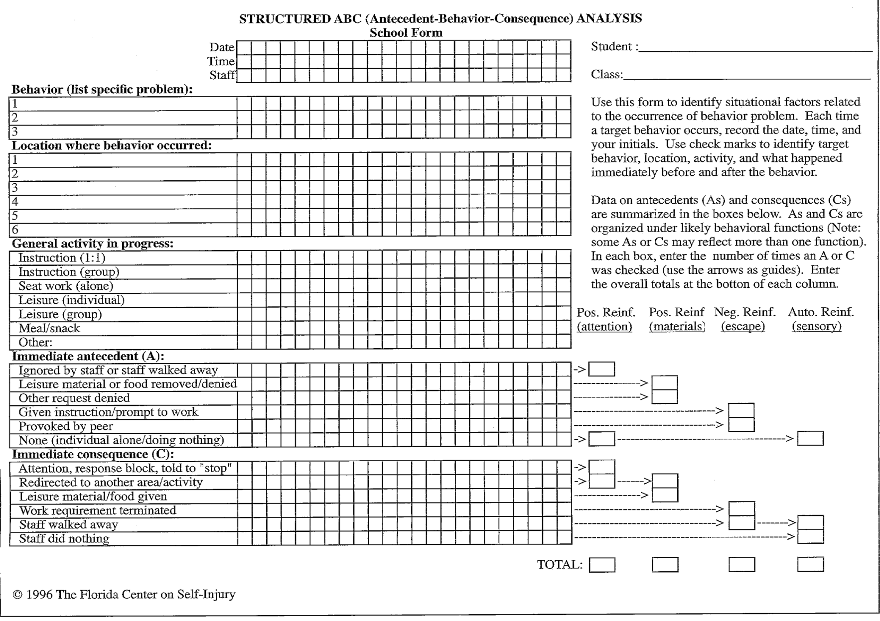
ABC Data Collection

Slide 9
Data Collection Practice: ABC Recording

Slide 10
Scatter Plots
A two dimensional graph that shows the relative distribution of individual measures in a data set with respect to the variables depicted on the x and y axis.
Data points are not connected.
Can reveal relationships among different subsets of data
Example: a researcher looks at individuals of different demographic groups and the relationship to speed of driving, safe driving habits, etc.
Cooper, Heron, & Heward, 2007

Slide 11
Continuous Measurement
Frequency Collection: A ratio of count per observation time
Calculated by dividing the # of responses recorded by the number of standard units of time (30 times per hour, per day, etc.)
Also used interchangeably with rate

Slide 12
Data Collection Practice: Frequency Recording

Slide 13
Continuous Measurement
Duration Collection: A measure of the total extent of time in which a behavior occurs

Slide 14
Data Collection Practice: Duration Recording
Measure off task behavior

Slide 15
Continuous Measurement
Latency: a measure of temporal locus; the elapsed time from the onset of the stimulus to the initiation of a response

Slide 16
Data Collection Practice: Latency Recording
Latency between instruction and follow through.

Slide 17
Continuous Measurement
Interresponse Time (IRT): The amount of time that elapses between two consecutive instances of a response class.

Slide 18
Data Collection Practice: IRT
Record the time between flops

Slide 19
Discontinuous Measurement
Partial Interval Time Sampling: The observation period is divided into a series of brief intervals (typically 5-10 seconds). The observer records whether or not the behavior occurred at any time during the interval
NOT concerned with frequency or duration
Tends to OVERESTIMATE behavior
Use for behaviors targeted for decrease (we want to take data conservatively)
I know what you’re thinking.. Our intervals are more like 10-15 MINUTES in length…

Slide 20
Data Collection Practice: Partial Interval
Eating Behavior- 10 second intervals
Defined as: the child puts food to her mouth and puts it in her mouth, and/or chews food.
https://www.youtube.com/watch?v=sA-heKVuirM&list=PLtQXgKYtV8Ytsxx-xZSxxxIiMtwG6QWGG&index=1

Slide 21
Discontinuous Measurement
Whole Interval Time Sampling: The observation period is divided into a series of brief intervals (typically 5-15 seconds). The observer records whether or not the behavior occurred for the ENTIRE interval
Tends to underestimate behavior
Use for behaviors you want to increase (we like to take data conservatively)

Slide 22
Data Collection Practice: Whole Interval
Eating Behavior
https://www.youtube.com/watch?v=sA-heKVuirM&list=PLtQXgKYtV8Ytsxx-xZSxxxIiMtwG6QWGG&index=1

Slide 23
Discontinuous Measurement
Momentary Time Sampling: Records whether a behavior is occurring at the moment each time interval ends
A teacher’s best friend
May overestimate or underestimate behavior- may not be as accurate as other methods

Slide 24
Data Collection Practice: Momentary Time Sampling
Eating Behavior
https://www.youtube.com/watch?v=sA-heKVuirM&list=PLtQXgKYtV8Ytsxx-xZSxxxIiMtwG6QWGG&index=1

Slide 25
Permanent Product Recording
Permanent Product: a change in the environment produced by a behavior that lasts long enough for measurement to take place.
Measurement takes place AFTER the behavior has occurred
Can be natural or contrived
Photographs, homework, video, etc.

Slide 26
Planned Activity Check
PLACHECK: Uses head counts to observe group behavior. At the end of each interval, the teacher counts the number of students on task and records the tally along with the total # of students in the group.

Slide 27
Data Collection Practice: PLACHECK

Slide 28
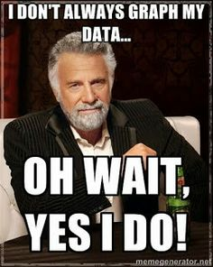
Turning Data into Graphs
Types of Graphs and When to use Each

Slide 29
Types of Graphs in ABA
Cumulative Record: The number of responses recorded during each observation period is added to the total number of responses recorded since the beginning of data collection
# of sight words mastered, # of words a child can speak, etc.
ALWAYS follows a stable or positive trend

Slide 30
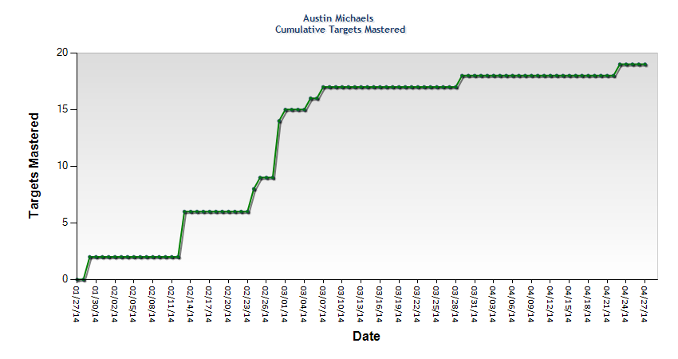
Cumulative Record

Slide 31
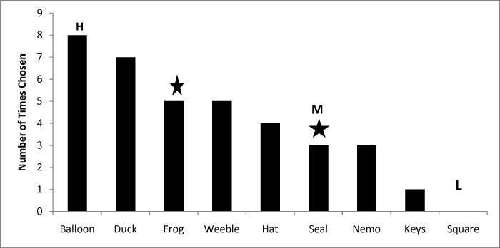
Types of Graphs in ABA
Bar Graphs: Used to compare performance across participants and/or conditions

Slide 32
Types of Graphs in ABA
Scatter Plot
Displays the presence and absence of a specific behavior across the day
Allows for visual evaluation of patterns of behavior across various variables (setting, activity, time of day, etc.)
Can be used as an assessment tool or to document changes in behavior

Slide 33
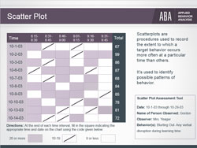
Scatter Plot

Slide 34
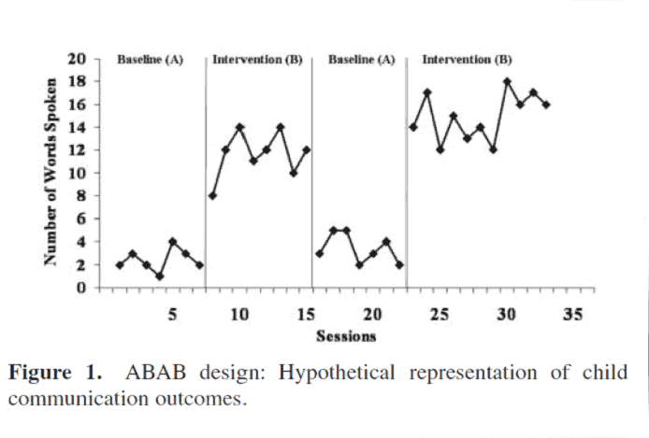
Types of Graphs in ABA
Equal Interval Line Graphs: The most common graph for displaying data in ABA
Multiple types: multiple baseline, changing criterion, etc.

Slide 35
Types of Graphs in ABA
Simple Line Graphs – ABA, ABAB, ABAC…
X Axis – horizontal axis. Typically represents a unit of time
Y Axis – vertical axis (ordinate). Typically represents a range of values of the dependent variable - some quantifiable dimension of behavior.

Slide 36
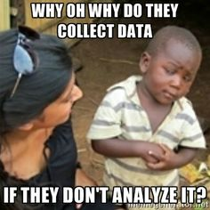
Types of Graphs in ABA: Visual Analysis
What we look for in a line graph:
Trend
Variability
Level
“Behavior Analysts employ a systematic form of examination known as visual analysis to interpret graphically displayed data."
- Cooper, Heron and Heward (2007, p.149)

Slide 37
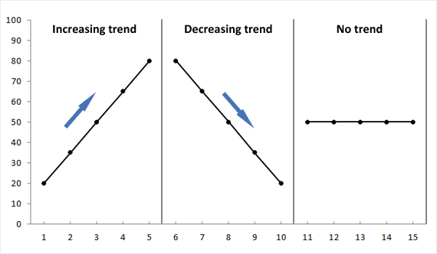
Visual Analysis of Data
Trend: The overall direction taken by a data path

Slide 38
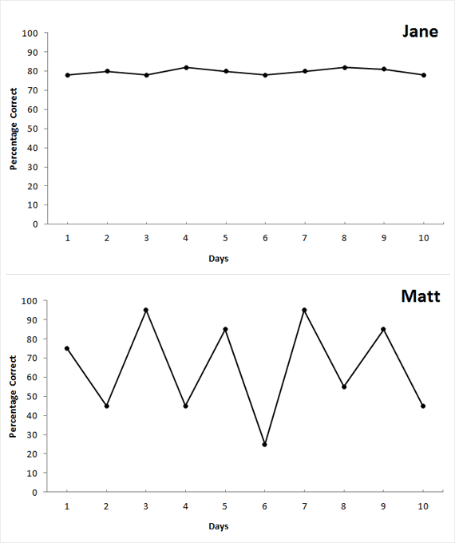
Visual Analysis of Data
Variability: The frequency and extent to which multiple measures of behavior yield different outcomes

Slide 39
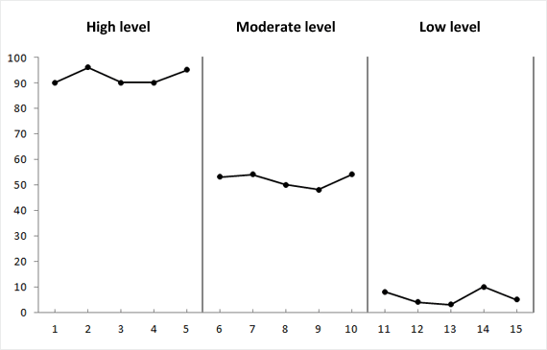
Visual Analysis of Data
Level: The value on the vertical axis around which a series of behavioral measures converge

Slide 40
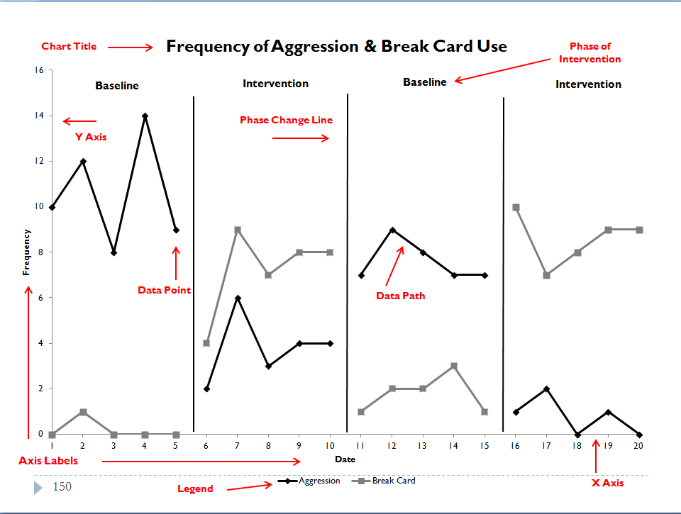
Parts of a Line Graph

Slide 41
Analyzing a Graph
Assess:
Variability
Level
Trend

Slide 42
Graphing Practice

Slide 43
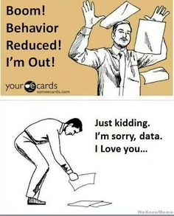
Thank you!!
References
Cooper, J.O., Heron, T.E., & Heward, W.L. (2007). Applied Behavior Analysis. Upper Saddle River, NJ: Pearson Education, Inc.

